Slide 1
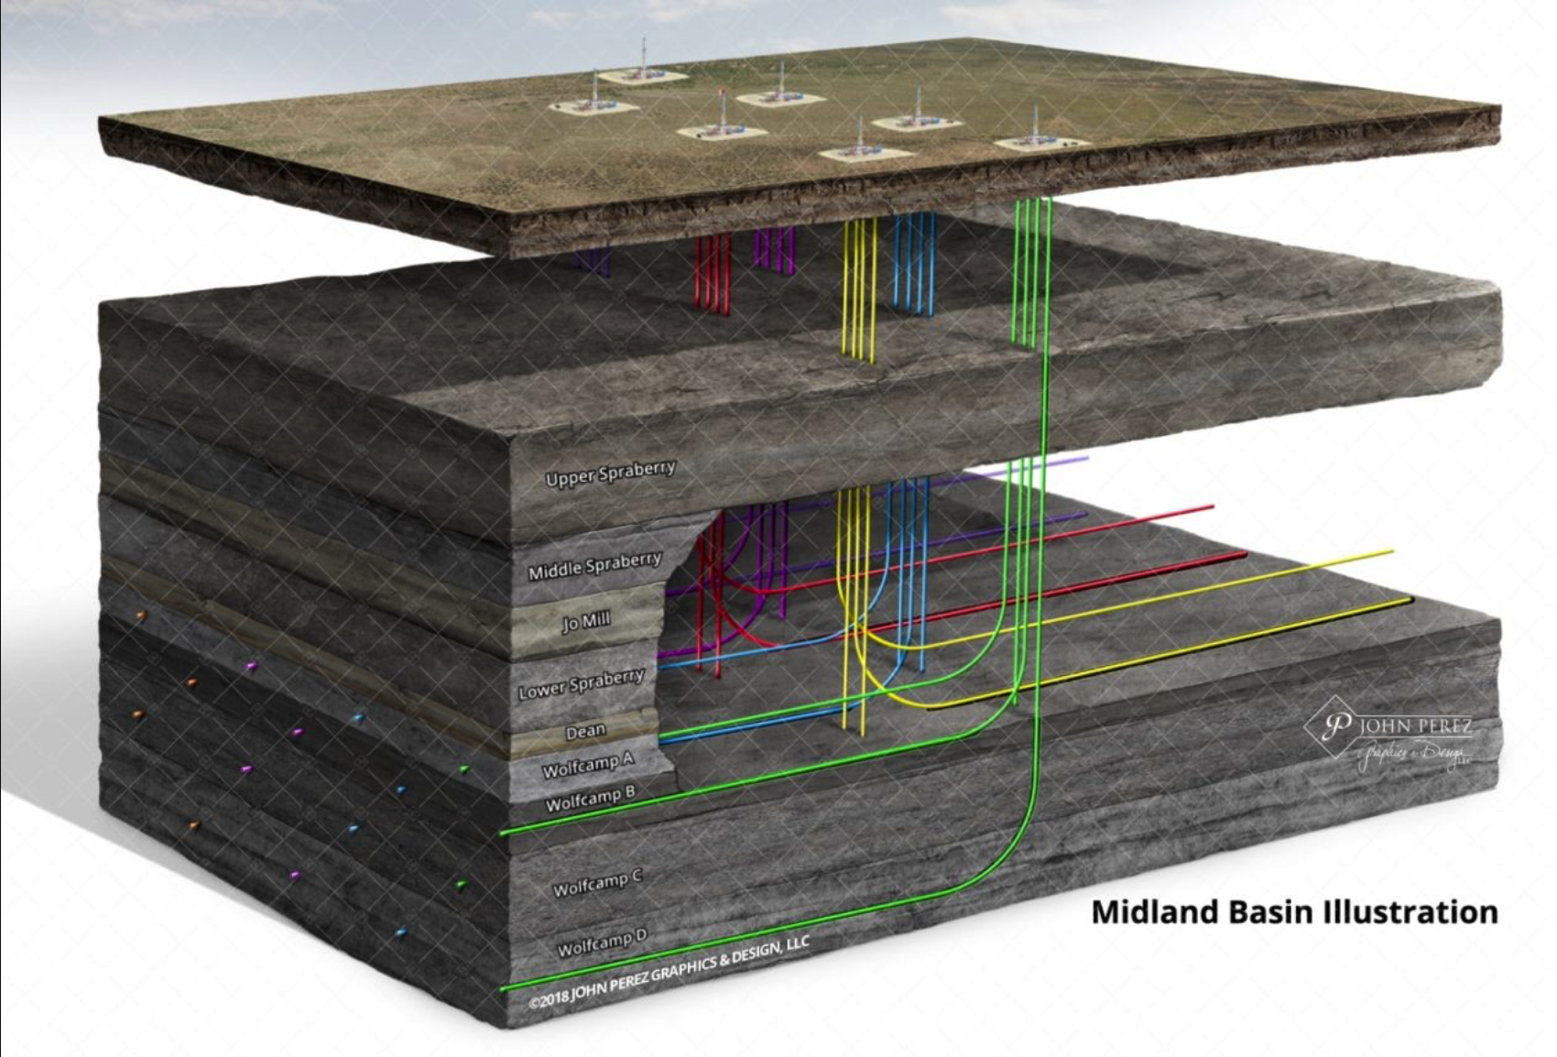
FTNF Report for CTOP
Finding Productive Oil Wells in the West Texas Permian Basin
Peter Flaming Matthew Trevathan Quinton Nixon Brock Friedrich

Slide 2
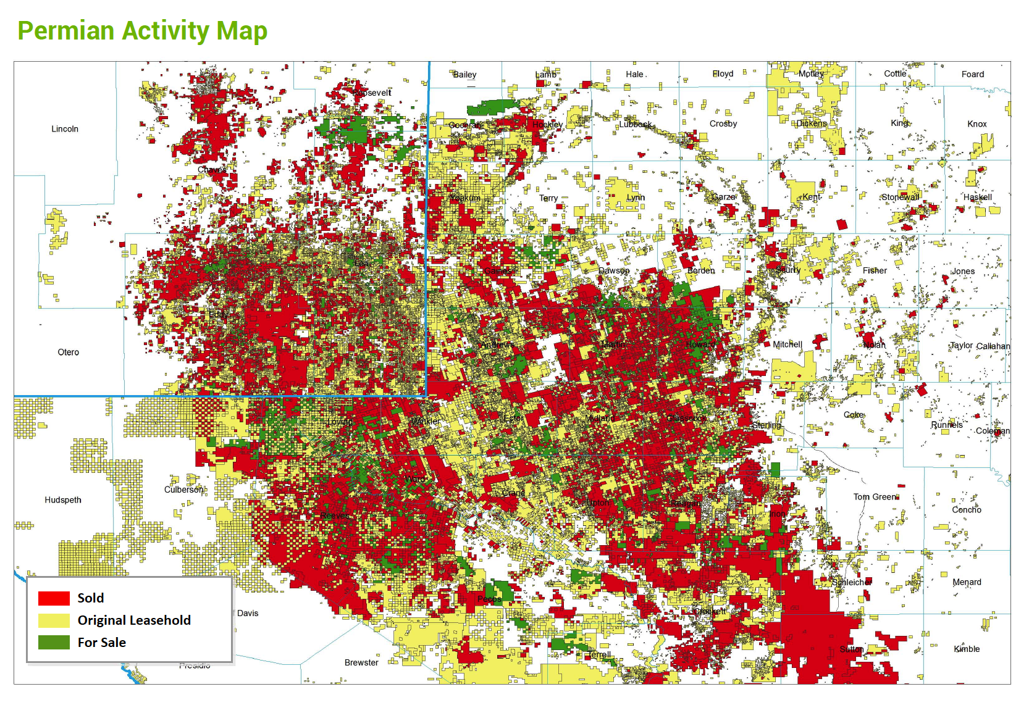
Study Outline
Business Objectives
Data Sourced
Methodology
Evaluation/Results
Summary
Page 2

Slide 3
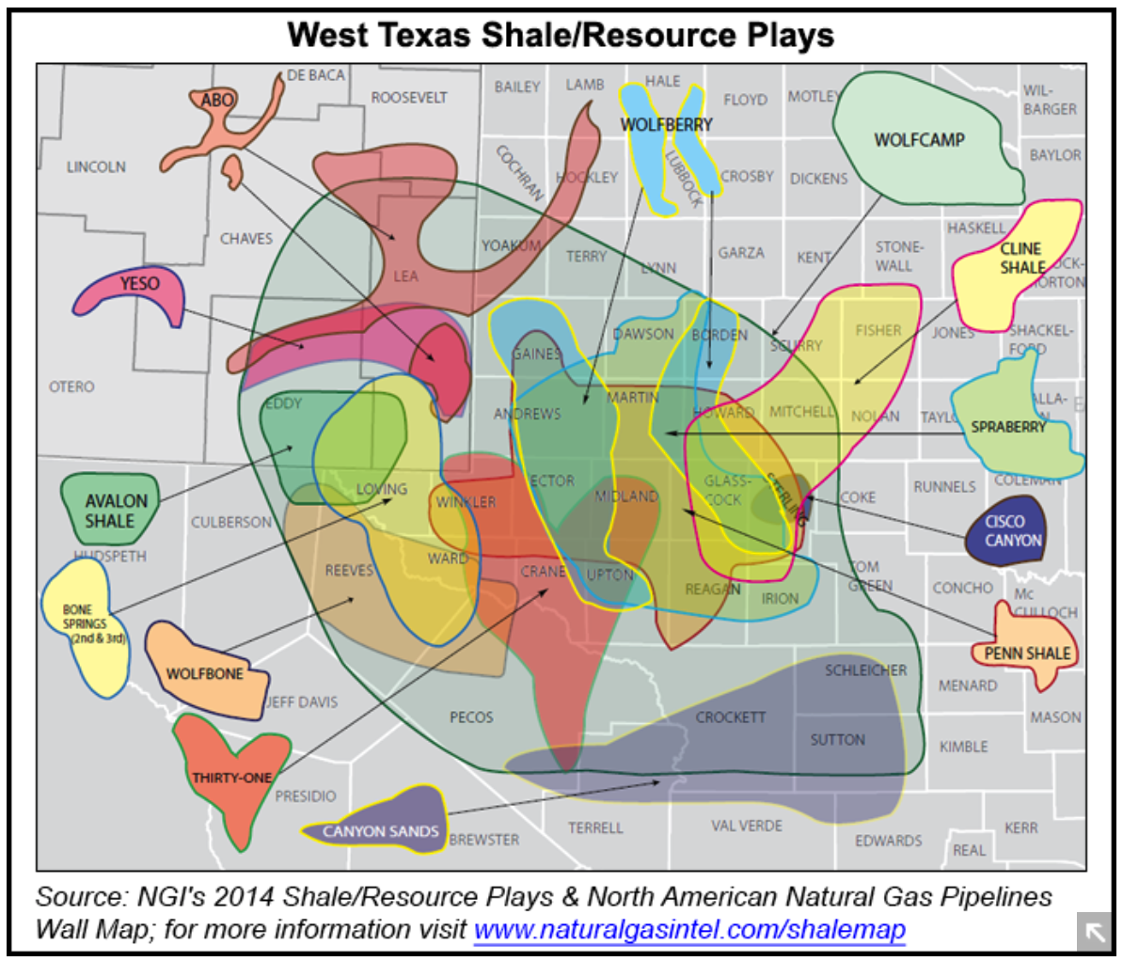
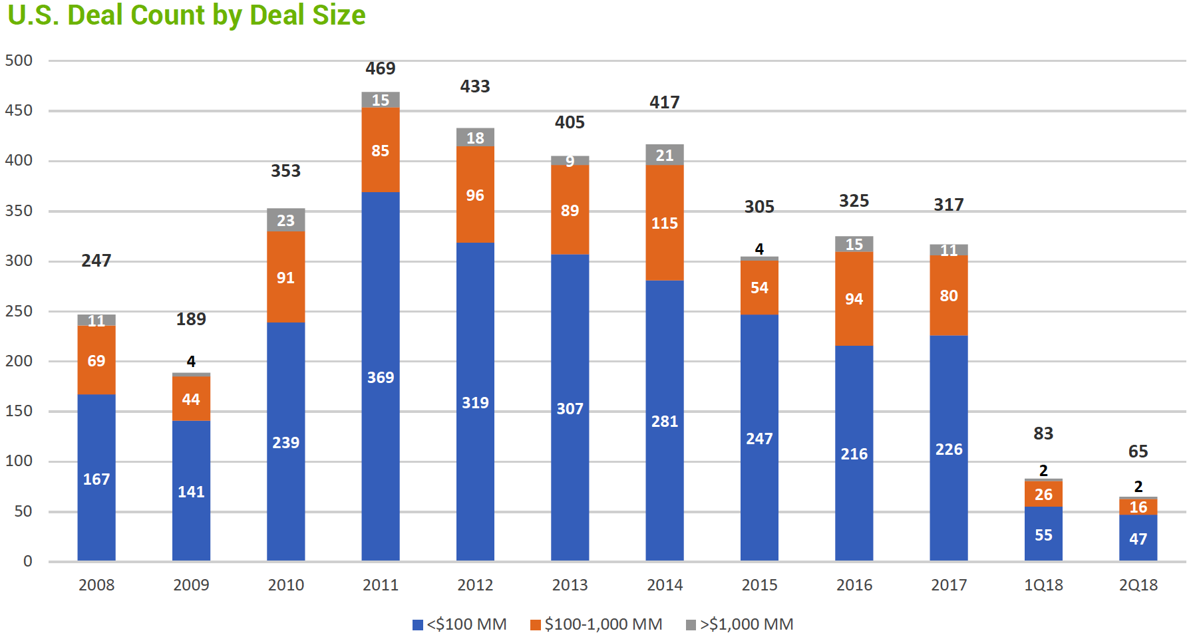
Business Objectives
Find (Cheap) Well Data
Uncover Key Aspects
Produce Quantified Results
Determine Linear Trends
Determine Top Plays
Market Overview
Where to deal and what to play?
Page 3

Slide 4
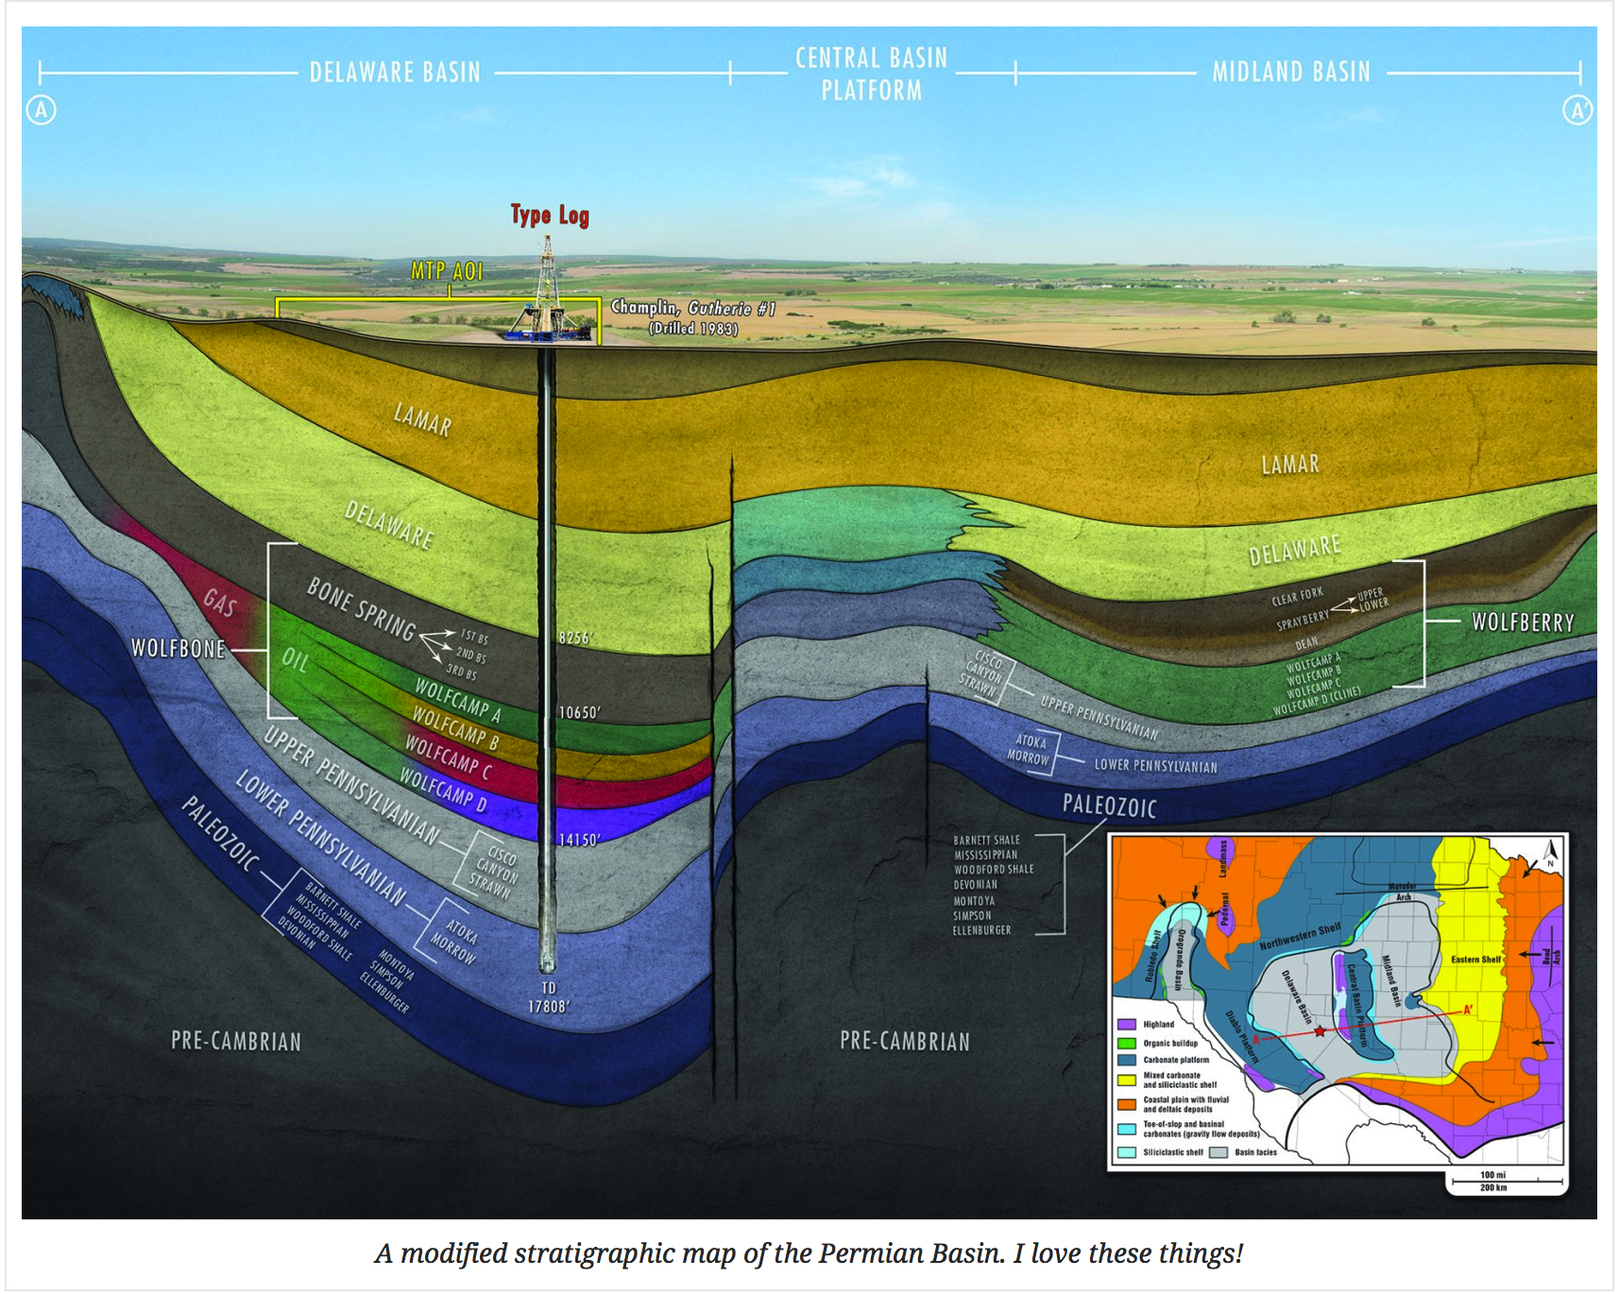
Research Questions
Questions
Does well productivity increase with 'frac size’?
How does it increase?
Are there regional trends?
Trends by formation?
Do additives affect oil productivity?
Page 4

Slide 5
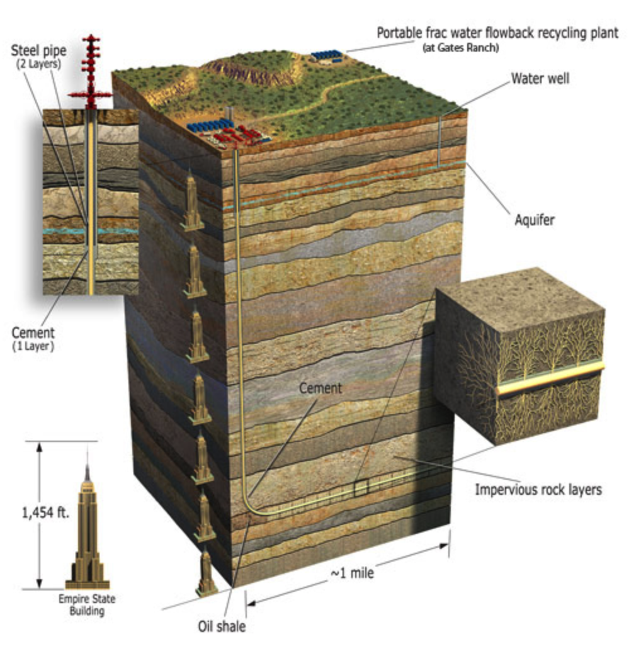
Data Source
Data
Driftwood
fracfocus.org
1,454ft x 5 = ~7300ft =
TVD
Quantify Everything!
Page 5

Slide 6
Data Sources
Client data – in-house dataset with key attributes of areas of interest including geological and operator information
Enriching data – data from a national registry with information about chemicals used in the fracturing process
Client data tells us who is doing what, enriching data tells us what they are using
Page 6

Slide 7
Methodology
Preparation
Understand the business needs of the client
Gather relevant data to address the needs
Explore, model, and predict
Workflow
Getting and cleaning data
Creating new predictor variables
Exploratory Data Analysis
Feature selection and model building
Interpretation and Conclusions
Page 7

Slide 8
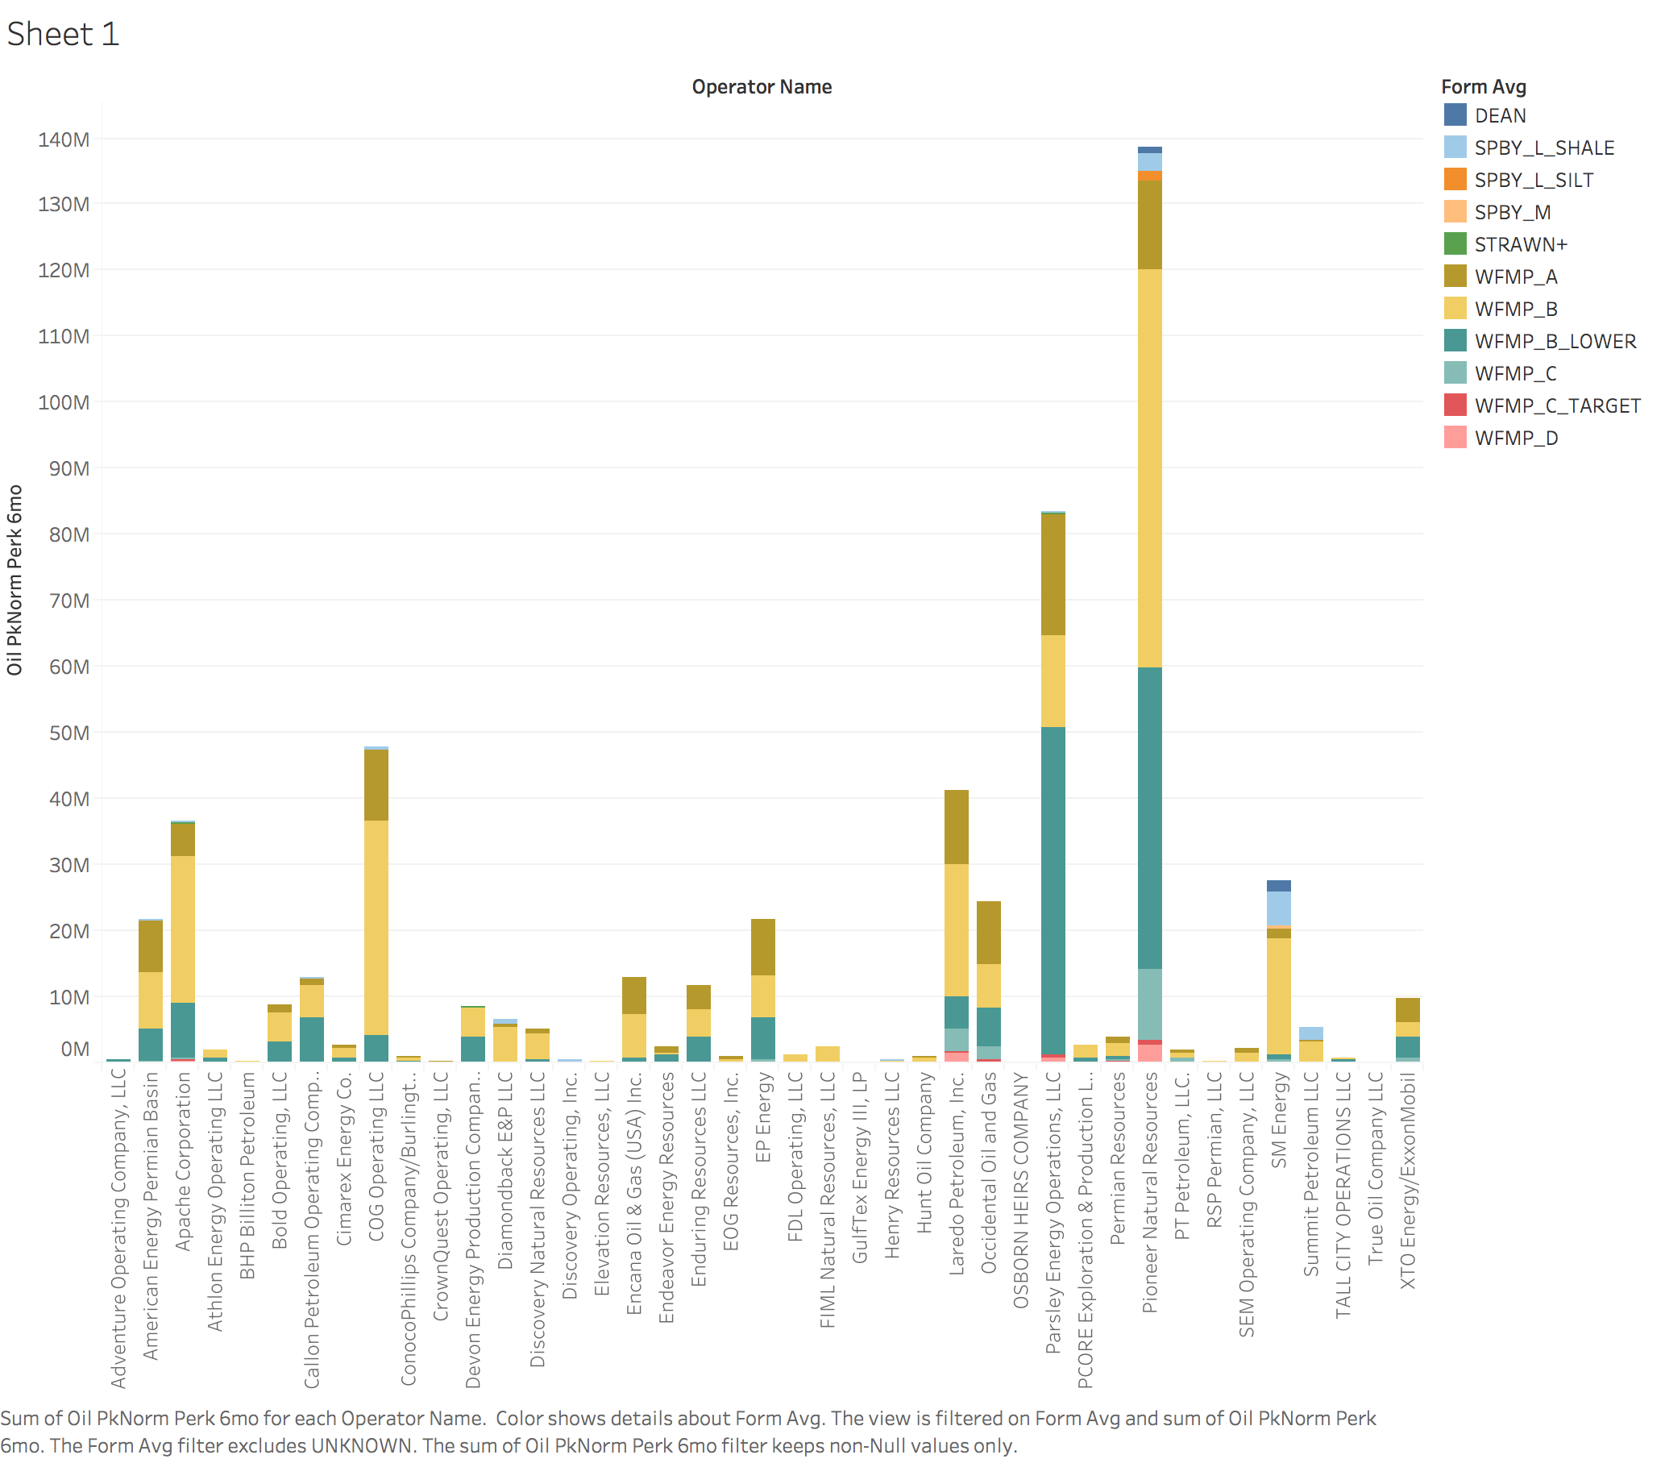
Exploratory Data Analysis
Oil Production by Company
Page 8

Slide 9
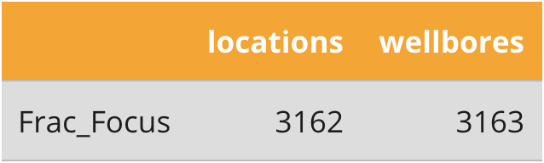
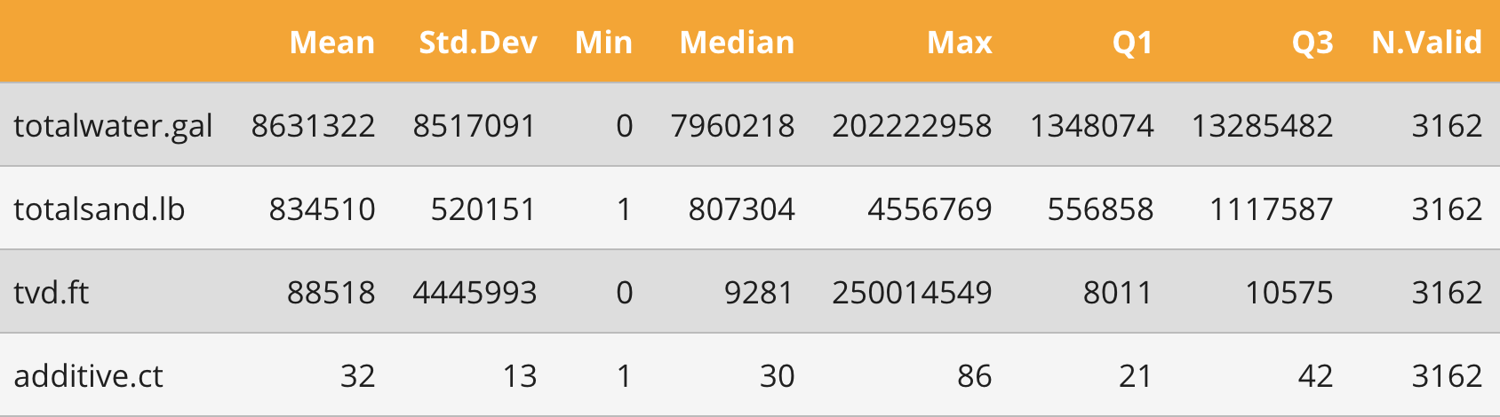
Exploratory Data Analysis
Locations
Aggregate additives
Page 9

Slide 10
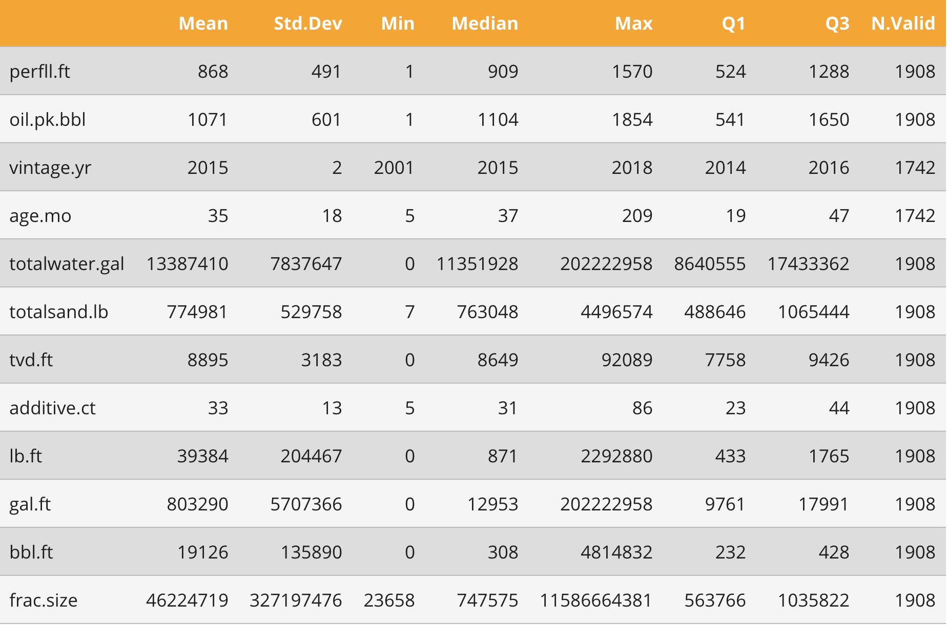
Exploratory Data Analysis
Summary of well data
Page 10

Slide 11
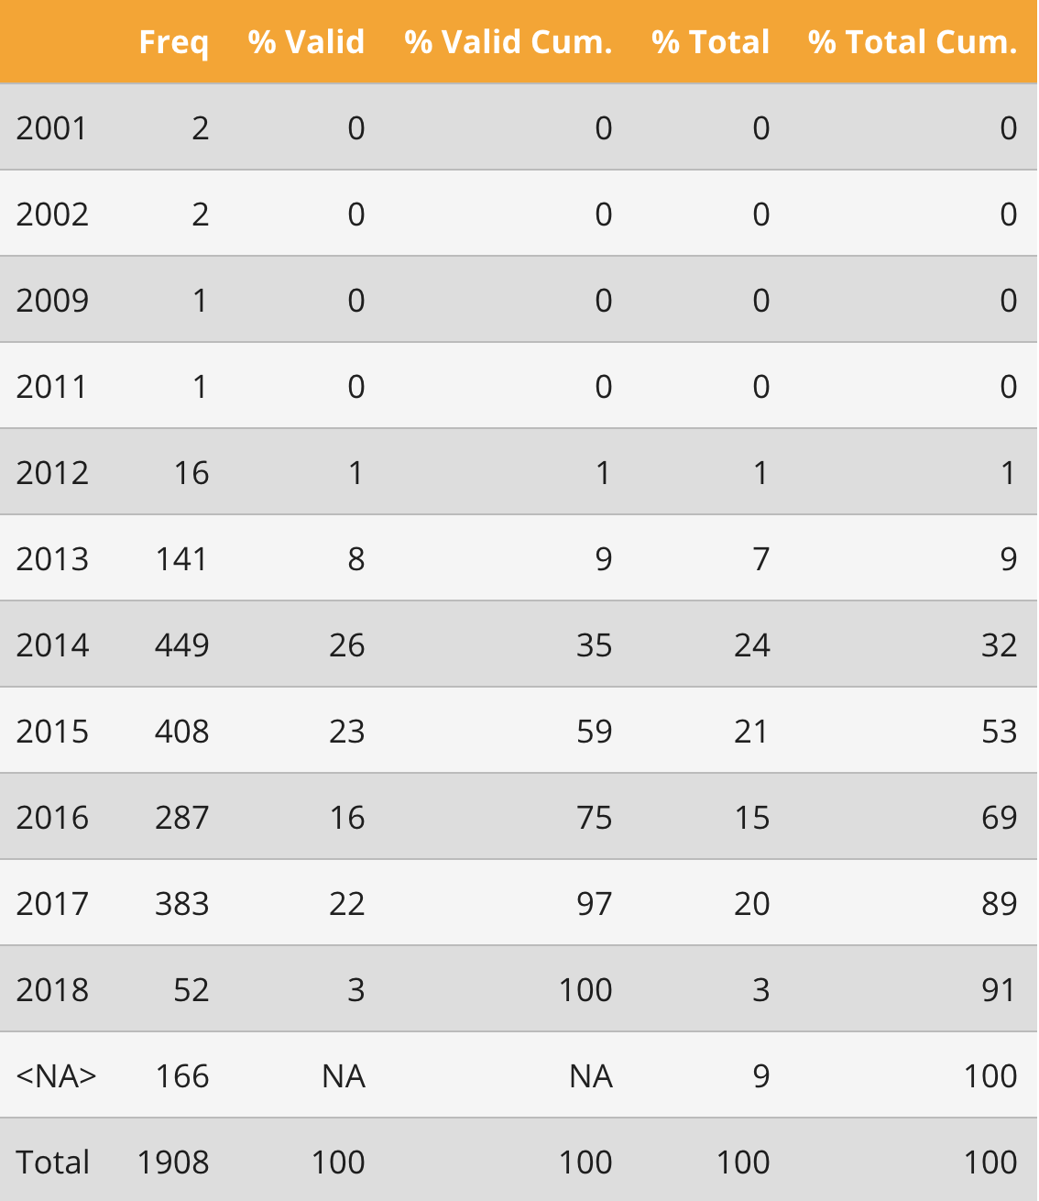
Exploratory Data Analysis
Summary of wells by year
Page 11

Slide 12
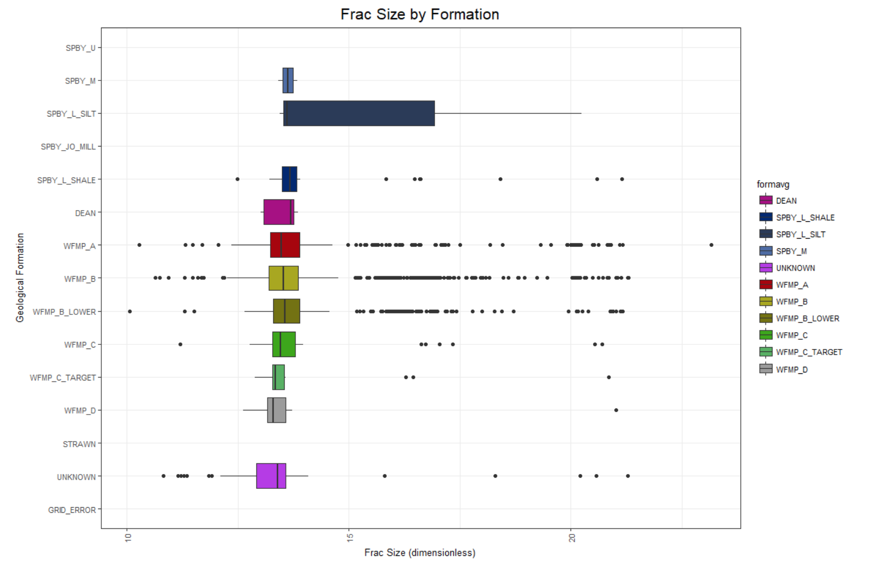
Exploratory Data Analysis
Fracture size by formation
Page 12

Slide 13
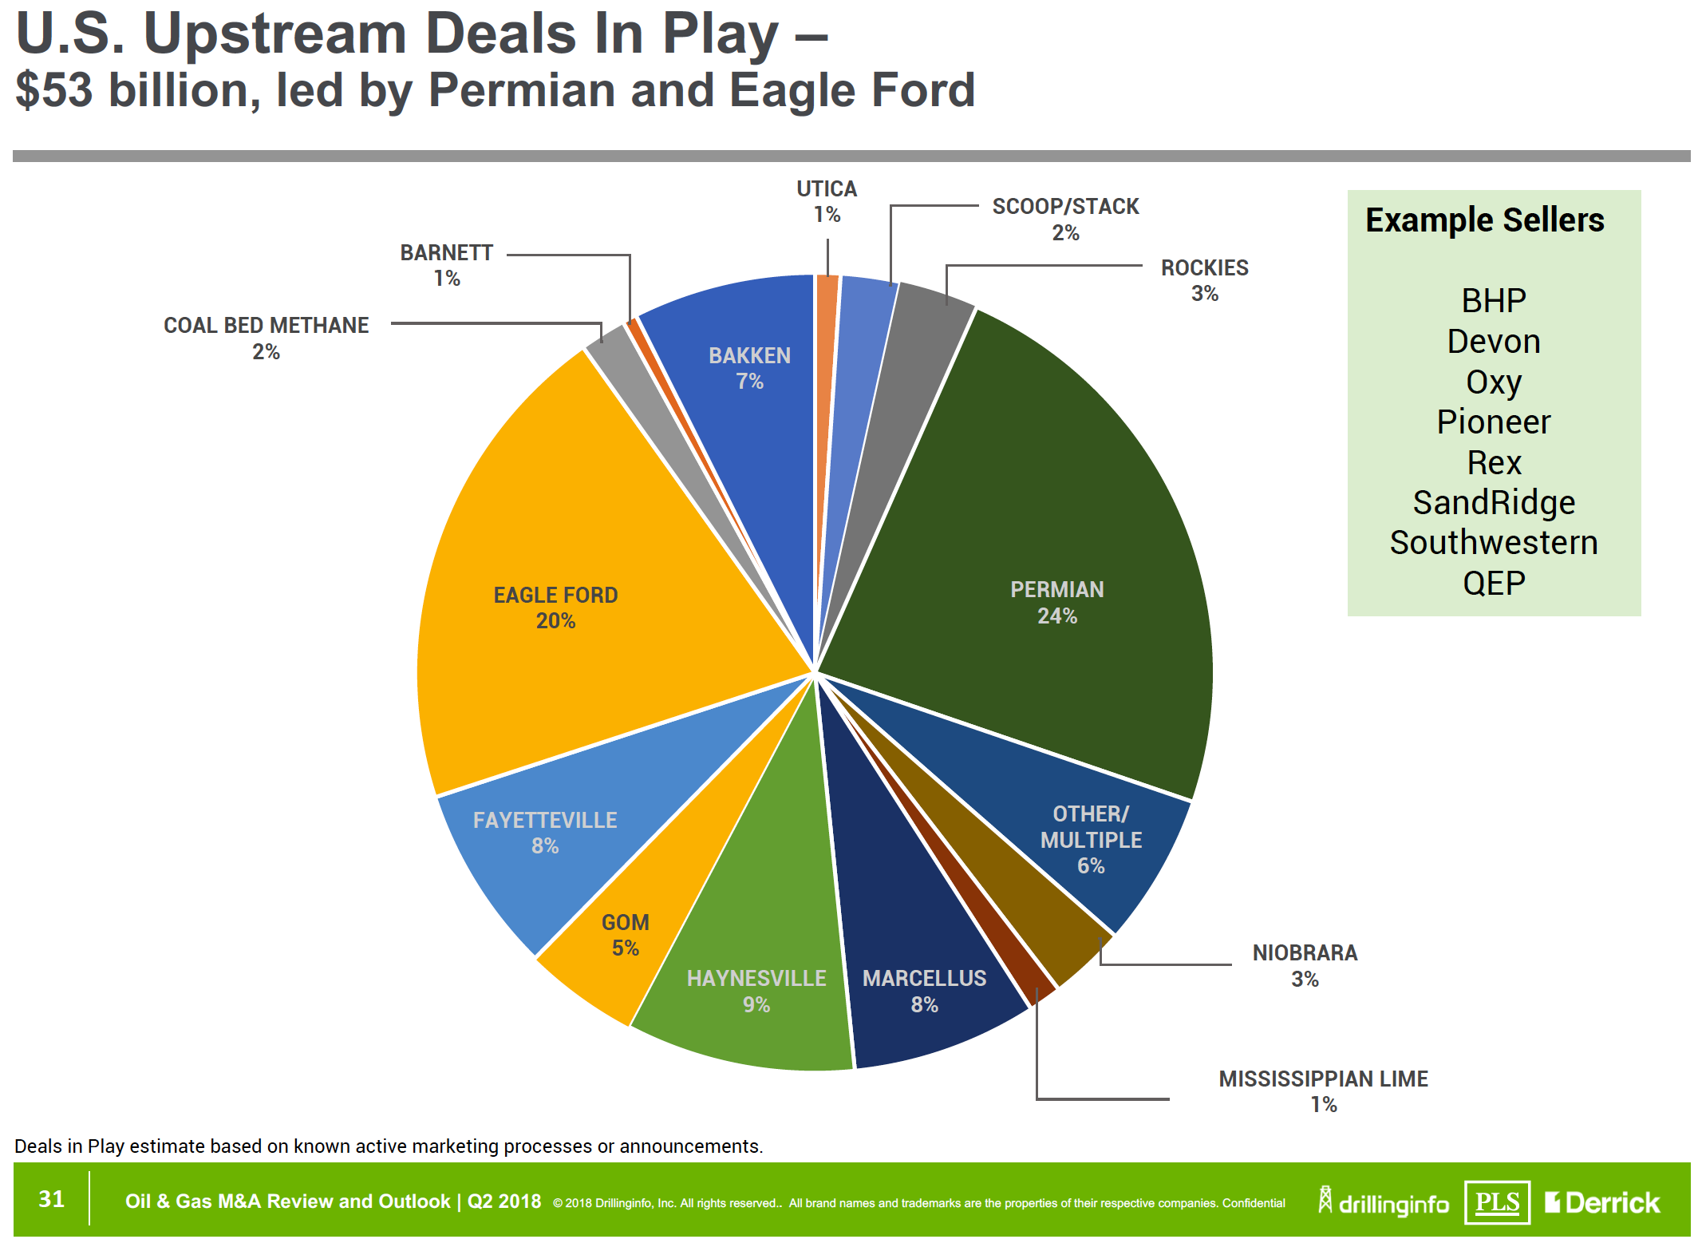
Multiple Linear Regression Model Evaluation
Production Trends by Geological Formation and Aggregate Interactions
Multiple Linear Regression Model
Formula = lm(log(oil.pk.bbl) ~ log(frac.size) : formavg, data=welldata)
Questions
Top Plays
Aggregate Characteristics
Relation to Market Trends
Expected Results
Basin Formation Trends
Unconventional Trends
Common Production Aspects
How does one go about eating that Permian slice?
Page 13

Slide 14
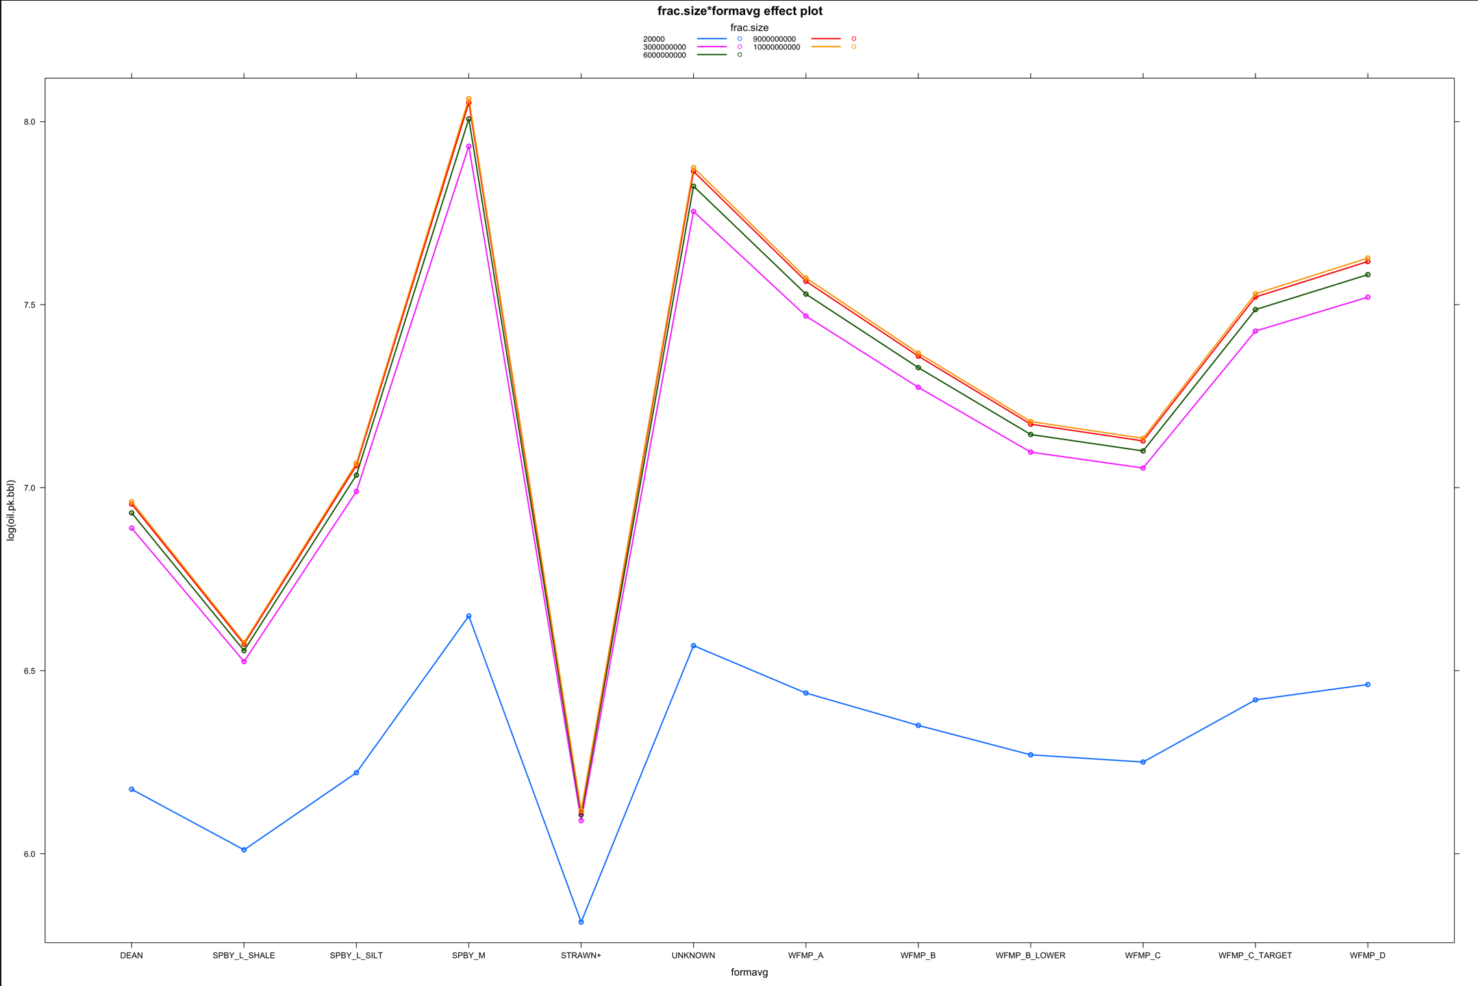
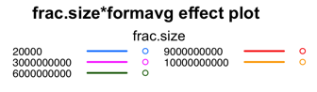
Multiple Linear Regression Model Results
Multiple Linear Regression Model Uncovers:
Top Plays and Aggregate Aspects
Well Production by Geological Formation and Aggregate Interactions
As the geological formation increases in depth, the relationship between aggregate and well production dramatically weakens for the low producing formations and increases for the high producing formations
Oil Production Response
Geological Formation and Aggregate Interactions
Page 14

Slide 15
Multiple Linear Regression Model Market Trends
Page 15

Slide 16
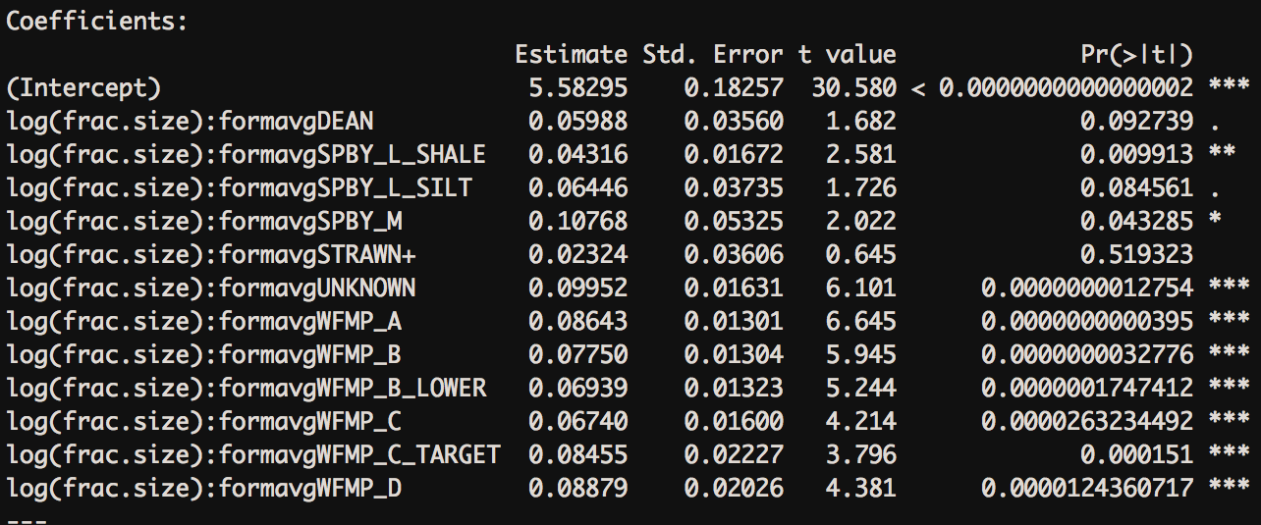
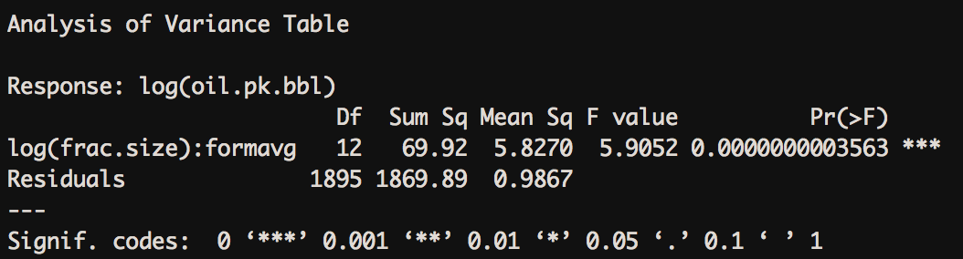
Multiple Linear Regression Model Results
Our Model was able to identify statistically significant interactions that could be used to predict well production of oil in unconventional plays within the Permian Basin, West Texas.
Page 16

Slide 17
Logistic Regression Model Evaluation
Prediction Model for Production of Oil by Hitting Target Depth for Geological Formations
Logistic Regression Model
Formula = glm(ynTVD~ form_avg + Oil_PkNorm_Perk_6mo + Latitude + Longitude + Projection, family = binomial(link = "logit"), data = Basin_Model_Data)
Questions
Top Plays
Formation Production
Relation to Market Trends
Expected Results
Basin Formation Trends
Conventional Trends
Production Prediction
How does one go about eating that Permian slice?
Page 17

Slide 18
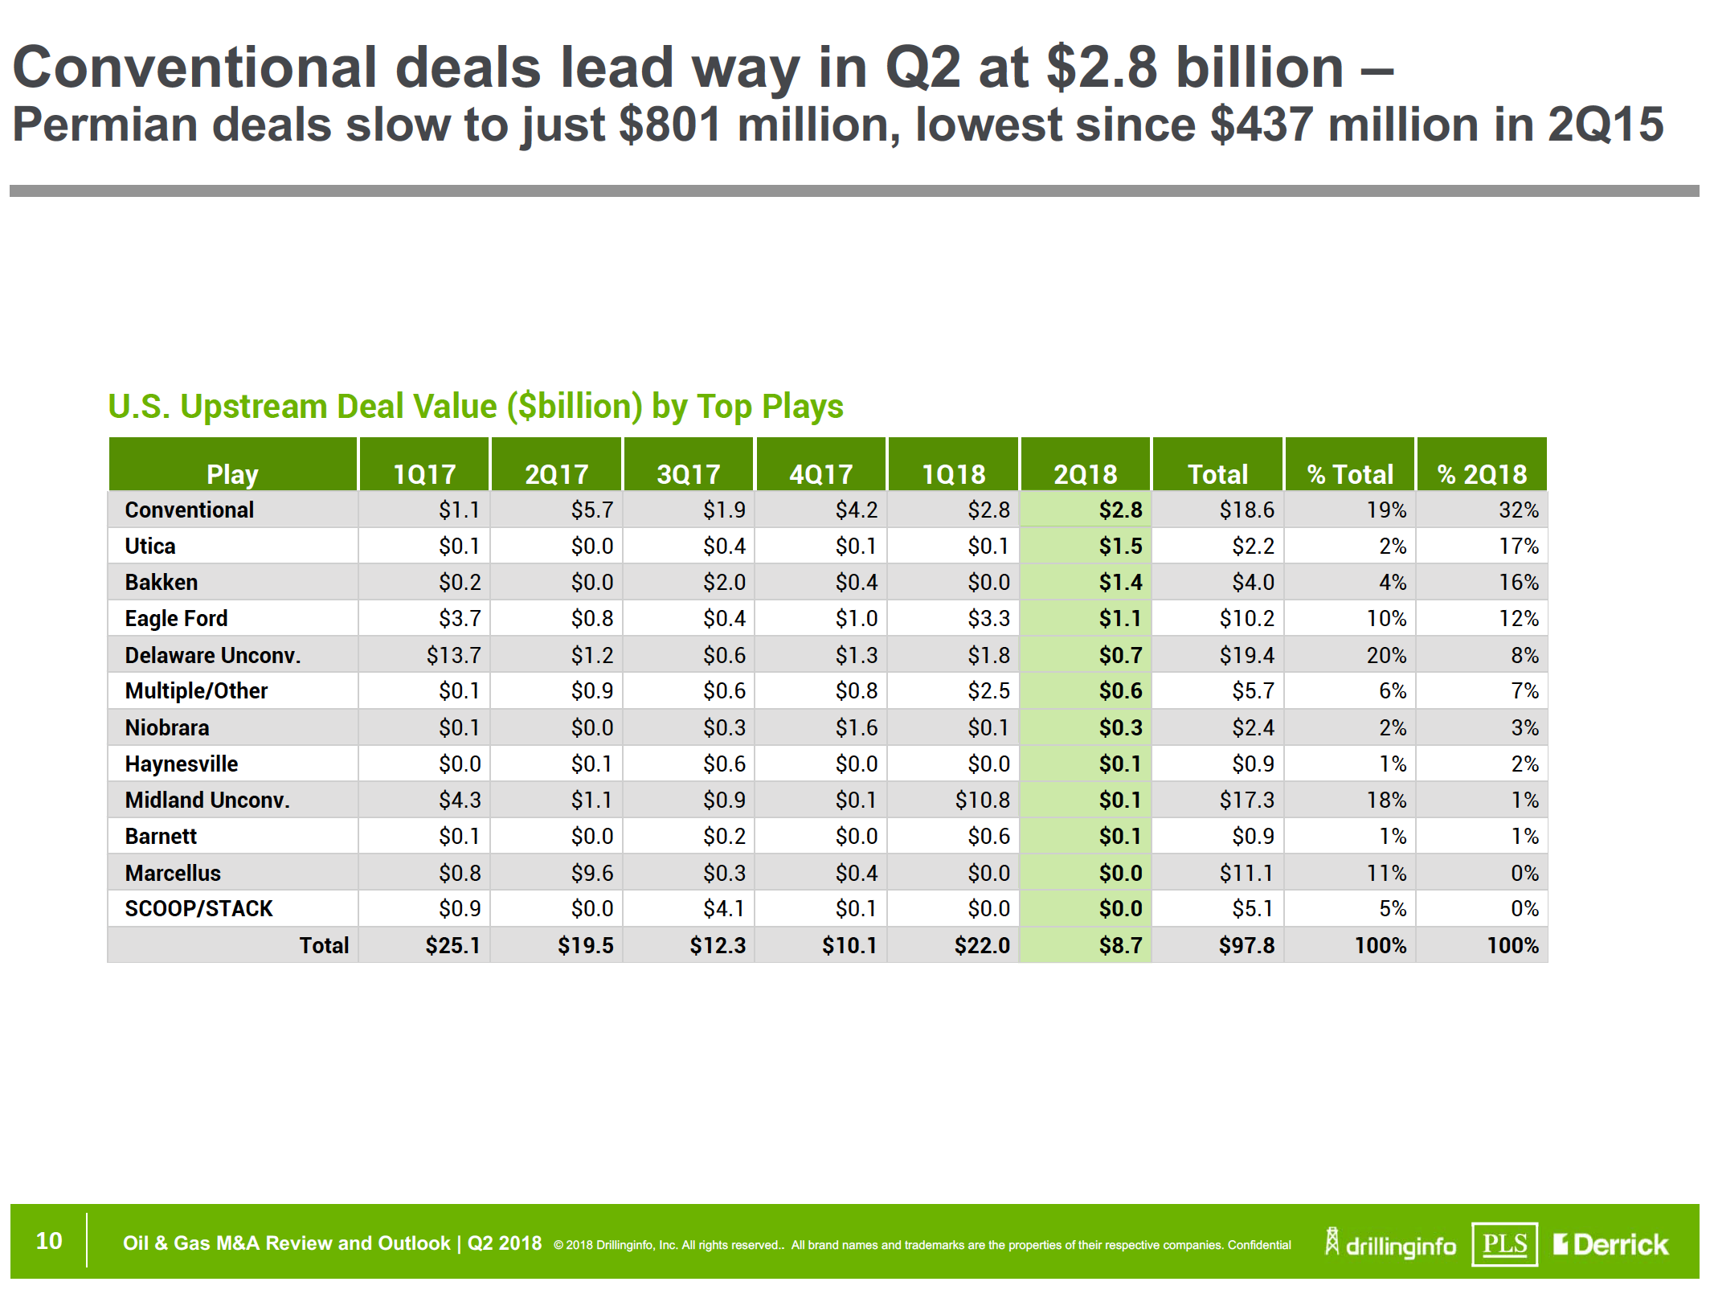
Logistic Regression Model Evaluation Results
Multiple Linear Regression Model Uncovers:
Prediction of Location for Top Plays
The geological formations predicted to be oil producing, are increasing their marketability as high producing formations
Page 18

Slide 19
Logistic Regression Model and Market Trends
Page 19

Slide 20
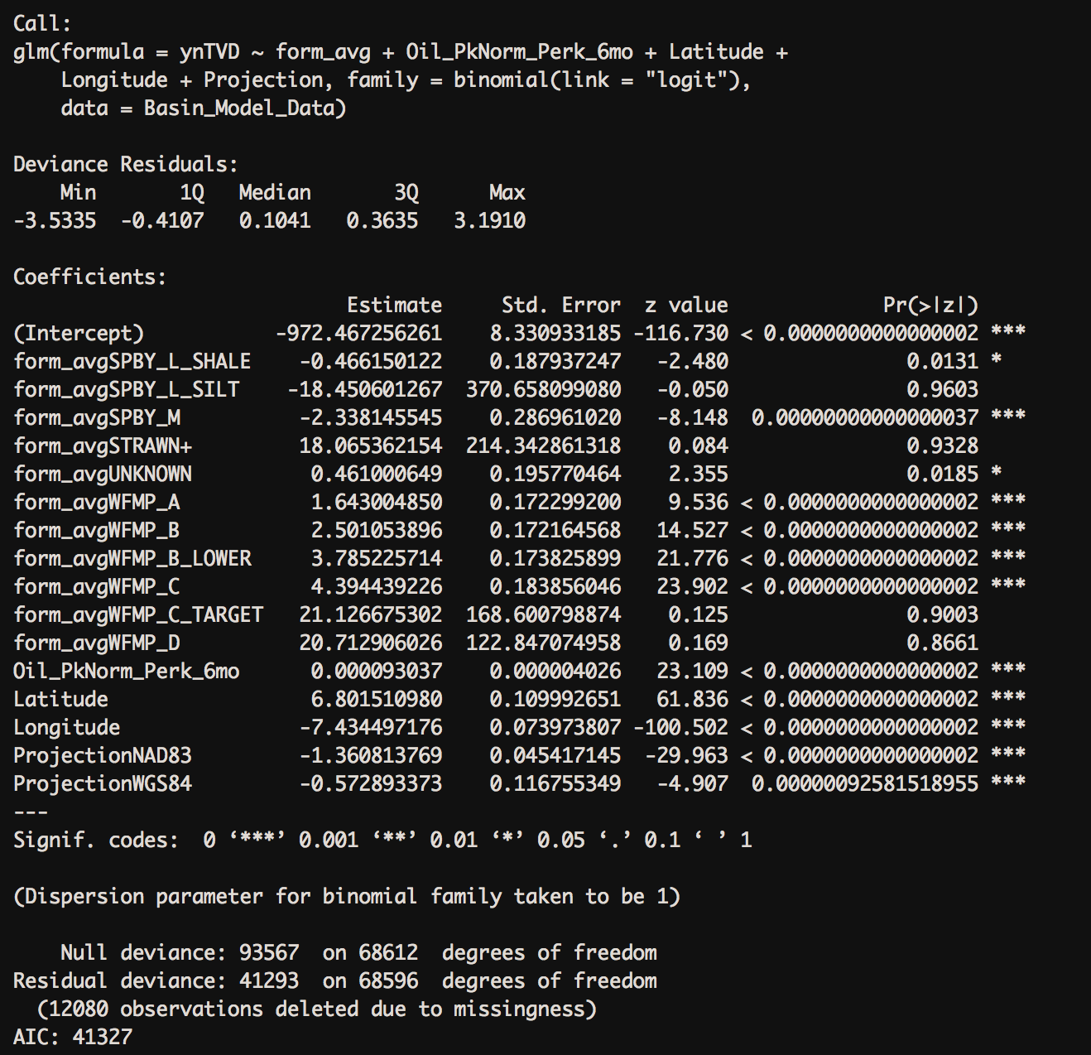
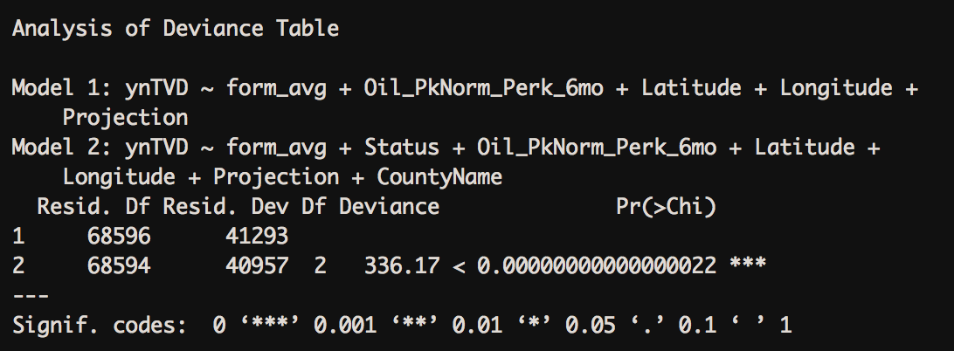
Logistic Regression Model Results
Our Model was able to identify statistically significant responses that can be used in subsurface formation location as a response to predicted producers in conventional plays within the Permian Basin, West Texas.
Page 20

Slide 21
Summary
Insights
From the Multiple Linear Regression Model we now have a good measure of what the Top Plays are in the Permian Basin and how these plays interact with the frac’ing aggregates during unconventional industry practices.
From the Logistic Regression Model we found it possible to successfully predict the formation oil production by the known depths of formations from producing well data.
Recommendations
Apply these models to more datasets throughout the Permian Basin.
Improvements
Implement Machine Learning and Cluster Analysis techniques to the datasets.
Expand to other oil and gas producing basins.
Page 21

Slide 22
Questions
Page 22

